Slide 1

Challenge 2: Grouping and Submodels in AEC design projects
Convert IFC models to LBD
Define stakeholder-specific “views” on the project data, based on the LBD ontologies
Connect geometric identifiers with semantic data
Design a user-friendly GUI to:
Define “views” as a domain expert
Visualise the results
OPTIONAL: include multiple RDF sources (“federated”)
It’s a window
It’s something that allows me to have a look to the outside
It’s a source to daylight
It’s a surface with low sound absorption
It’s a ventilation opening
It’s a smoke hatch
It’s a fire escape
It’s an asset that requires cleaning and painting
It’s a part of the building envelope with poor insulation
https://github.com/SSoLDAC-2022/Challenge-2

Slide 2
Two approaches
1
There are 5 types of doors in the project:
A, B, C, D and E
Properties described at type level are also valid
for the instances of that type
Besides type properties, the elements also have
instance properties
2
All doors are unique but with grouping mechanisms
it’s possible to batch-assign properties
For practitioner A it’s only important to distinguish
based on frame color
For practitioner B it’s relevant whether the door is
placed in an the facade, in an apartment or in a common
area
For practitioner C it’s relevant to group by hinge side

Slide 3
Element type
Element properties
Resulting groups
Door
Window
Wall
Roof
Slab
Pipe
Duct
Fitting
Width
Height
Frame-thikness
Glazing-area
Fire rating
Sill height
Windows A
12pcs
Width: 900 mm
Height: 2100 mm
Windows B
5pcs
Width: 1500 mm
Height: 1800 mm
Windows C
32pcs
Width: 1200 mm
Height: 1400 mm
So this is your grouping definition
Which properties do you wish to
attach to instances of each group?
U-value? Price? Maintainance cost?

Slide 4
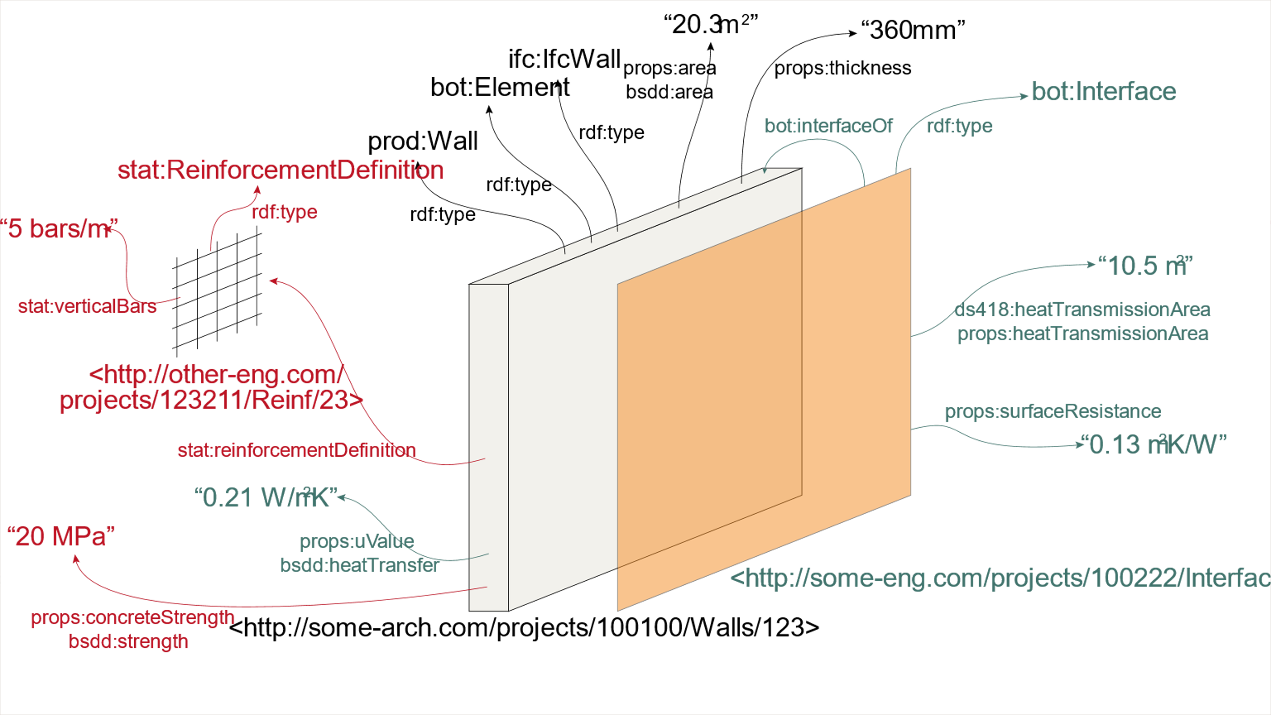
OPTIONAL: Federation
SOURCE I
SOURCE III
SOURCE II

